Slide 1
A feature selection approach to increasing classification performance

Slide 2
System Architecture
Input data set
Apply SU
Calculate CCE between every feature
Convert binary weighted matrix
Compare with existing
Group the similar weighted features in one cluster
Choose the strong feature in each cluster
Subset of features

Slide 3
System Working
CSV File as input
X | y
43 | 99
 | 10 | 20
21 | 65
25 | 79
10 | 12 | 58
42 | 75
57 | 87
59 | 81
10

Slide 4
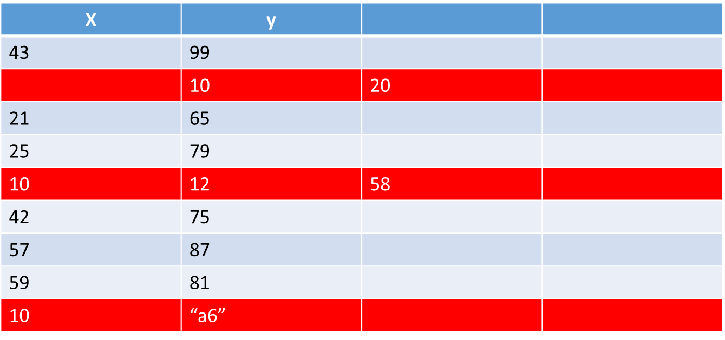
Data Preprocessing
Noisy and Missing values Mislabeled Imbalanced
3 rows are drop due to invalid data
6 rows are selected for next processing

Slide 5
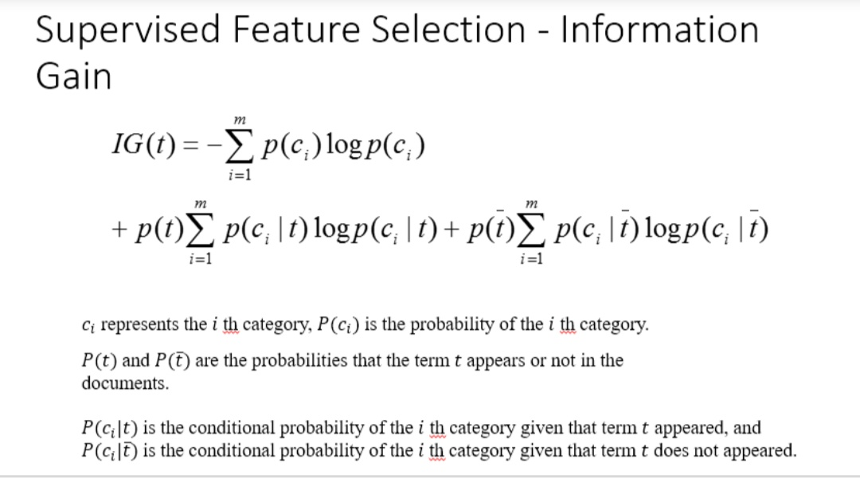
Find SU for each feature and sort decending order by SU
SU | Feature No | Feature Name
.19 | 10 | j
.19 | 8 | h
.19 | 7 | g
.18 | 9 | i
.15 | 2 | b
.09 | 1 | a
.07 | 4 | d
.06 | 3 | c
.06 | 5 | e
.02 | 6 | f
SU=(2*IG)/(H(X)+X(Y))
H(X)=-∫p(x)log(p(x))შx

Slide 6
Choose the middle feature’s SU value as t
SU | Feature No | Feature Name
.19 | 10 | j
.19 | 8 | h
.19 | 7 | g
.18 | 9 | i
.15 | 2 | b
.09 | 1 | a
.07 | 4 | d
.06 | 3 | c
.06 | 5 | e
.02 | 6 | f
T=.15

Slide 7
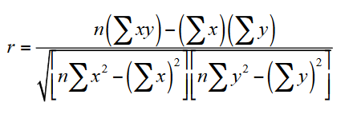
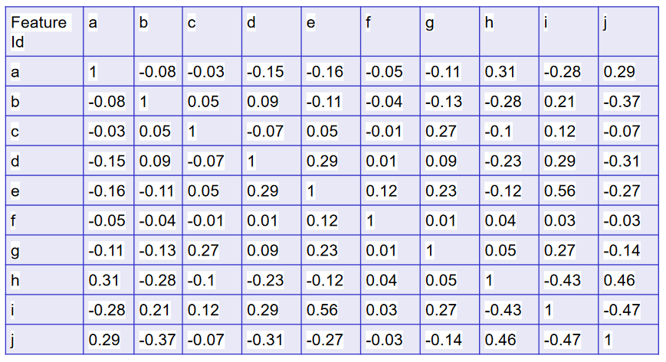
Generate the Correlation coefficient symmetrical matrix

